Slide 1
Heap sort
a.k.a. heapsort

Slide 2
Outline
This topic covers the simplest Θ(n ln(n)) sorting algorithm: heap sort
We will:
define the strategy
analyze the run time
convert an unsorted list into a heap
cover some examples
Bonus: may be performed in place

Slide 3
Heap Sort
8.4.1
Recall that inserting n objects into a min-heap and then taking n objects will result in them coming out in order
Strategy: given an unsorted list with n objects, place them into a heap, and take them out

Slide 4
Run time Analysis of Heap Sort
8.4.1
Taking an object out of a heap with n items requires O(ln(n)) time
Therefore, taking n objects out requires
Recall that ln(a) + ln(b) = ln(ab)
Question: What is the asymptotic growth of ln(n!)?

Slide 5
Run time Analysis of Heap Sort
8.4.1
Using Maple:
> asympt( ln( n! ), n );
The leading term is (ln(n) – 1) n
Therefore, the run time is O(n ln(n))

Slide 6
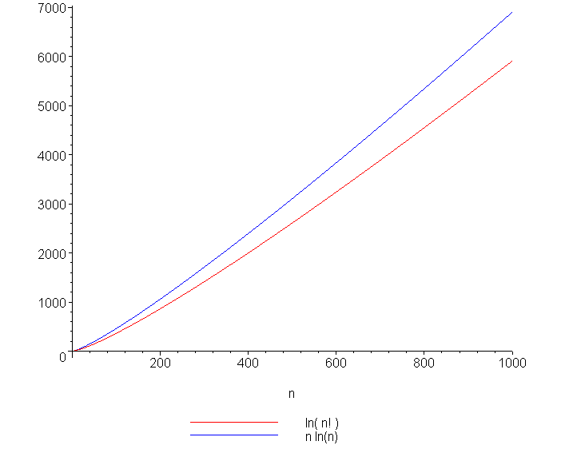
ln(n!) and n ln(n)
8.4.1
A plot of ln(n!) and n ln(n) also suggests that they are asymptotically related:

Slide 7
Aside: Calculating ln(n!)
8.4.1
Due to the incredible growth of n!
200! cannot be represented by a double-precision floating-point number
it is difficult to calculate ln(n!)
Often a function lgamma, ln_gamma or lnGAMMA is defined to calculate ln(n!) without the intermediate calculation of n!
The actual definition is
ln( n! ) == lgamma( n + 1 )

Slide 8
In-place Implementation
8.4.2
Problem:
This solution requires additional memory, that is, a min-heap of size n
This requires Θ(n) memory and is therefore not in place
Is it possible to perform a heap sort in place, that is, require at most Θ(1) memory (a few extra variables)?

Slide 9
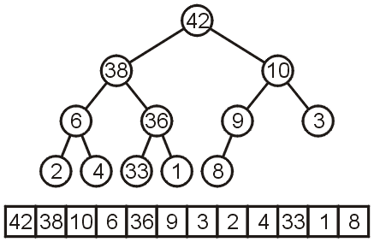
In-place Implementation
8.4.2
Instead of implementing a min-heap, consider a max-heap:
A heap where the maximum element is at the top of the heap and the next to be popped

Slide 10
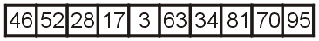
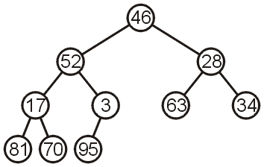
In-place Heapification
8.4.2
Now, consider this unsorted array:
This array represents the following complete tree:
This is neither a min-heap, max-heap, or binary search tree

Slide 11
In-place Heapification
8.4.2
Now, consider this unsorted array:
Additionally, because arrays start at 0 (we started at entry 1 for binary heaps) , we need different formulas for the children and parent
The formulas are now:
Children 2*k + 1 2*k + 2
Parent (k + 1)/2 - 1

Slide 12
In-place Heapification
8.4.2
Can we convert this complete tree into a max heap?
Restriction:
The operation must be done in-place

Slide 13
In-place Heapification
Two strategies:
Assume 46 is a max-heap and keep inserting the next element into the existing heap (similar to the strategy for insertion sort)
Start from the back: note that all leaf nodes are already max heaps, and then make corrections so that previous nodes also form max heaps

Slide 14
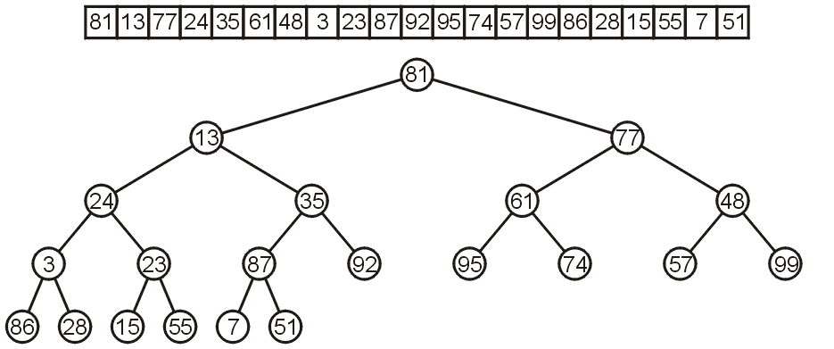
In-place Heapification
8.4.3
Let’s work bottom-up: each leaf node is a max heap on its own

Slide 15
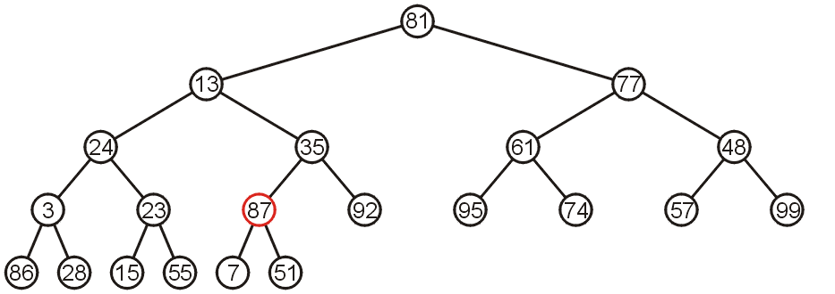
In-place Heapification
8.4.3
Starting at the back, we note that all leaf nodes are trivial heaps
Also, the subtree with 87 as the root is a max-heap

Slide 16
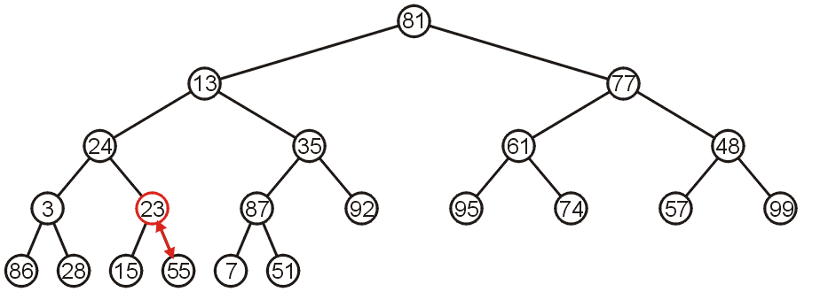
In-place Heapification
8.4.3
The subtree with 23 is not a max-heap, but swapping it with 55 creates a max-heap
This process is termed percolating down

Slide 17
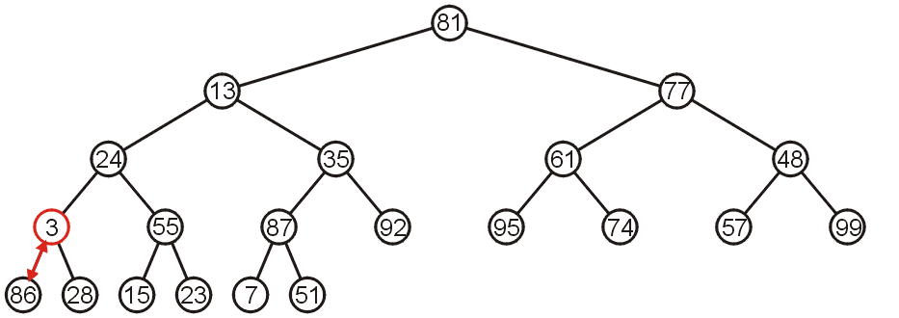
In-place Heapification
8.4.3
The subtree with 3 as the root is not max-heap, but we can swap 3 and the maximum of its children: 86

Slide 18
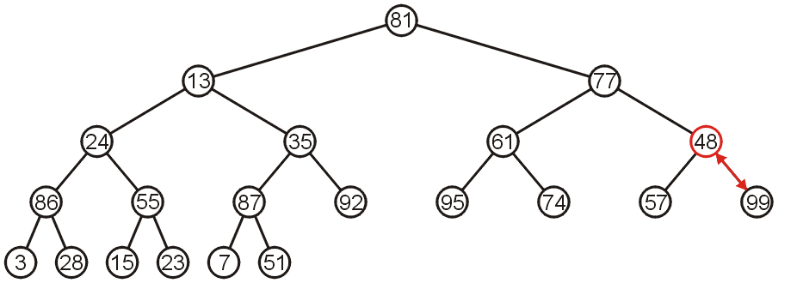
In-place Heapification
8.4.3
Starting with the next higher level, the subtree with root 48 can be turned into a max-heap by swapping 48 and 99

Slide 19
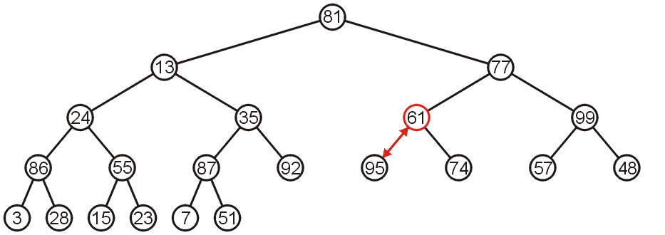
In-place Heapification
8.4.3
Similarly, swapping 61 and 95 creates a max-heap of the next subtree

Slide 20
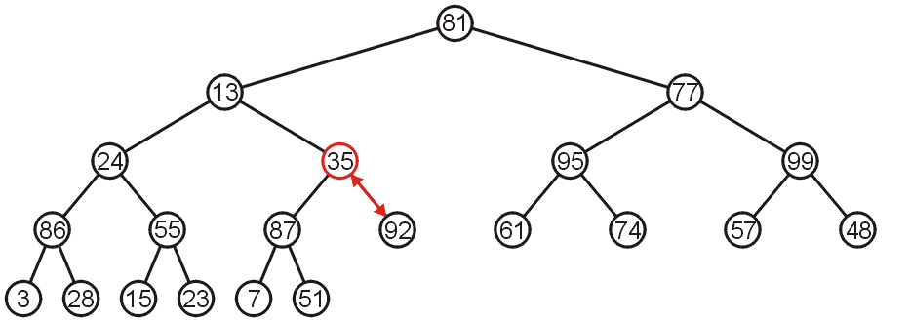
In-place Heapification
8.4.3
As does swapping 35 and 92

Slide 21
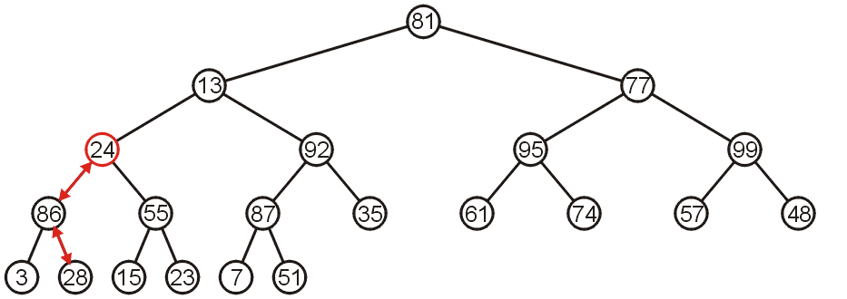
In-place Heapification
8.4.3
The subtree with root 24 may be converted into a max-heap by first swapping 24 and 86 and then swapping 24 and 28

Slide 22
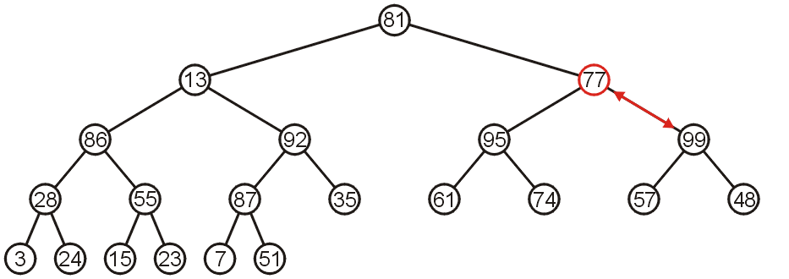
In-place Heapification
8.4.3
The right-most subtree of the next higher level may be turned into a max-heap by swapping 77 and 99

Slide 23
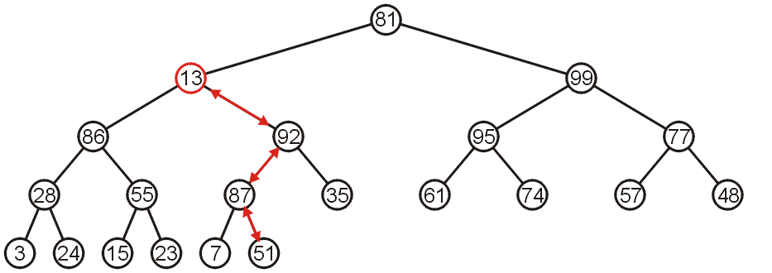
In-place Heapification
8.4.3
However, to turn the next subtree into a max-heap requires that 13 be percolated down to a leaf node

Slide 24
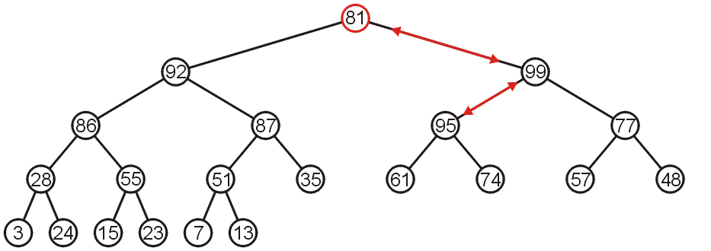
In-place Heapification
8.4.3
The root need only be percolated down by two levels

Slide 25
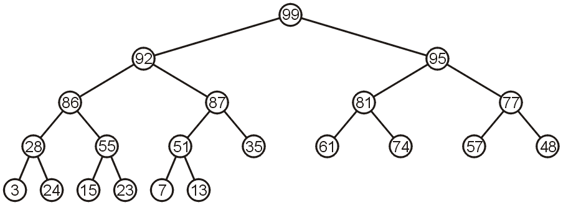
In-place Heapification
8.4.3
The final product is a max-heap

Slide 26
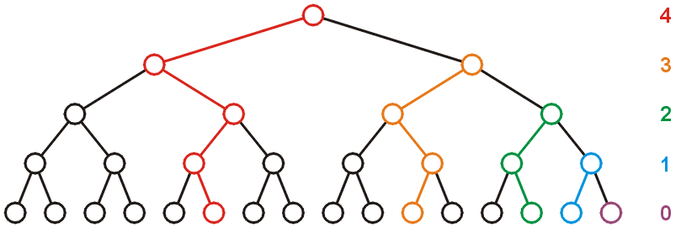
Run-time Analysis of Heapify
8.4.3.1
Considering a perfect tree of height h:
The maximum number of swaps which a second-lowest level would experience is 1, the next higher level, 2, and so on

Slide 27
Run-time Analysis of Heapify
8.4.3.1
At depth k, there are 2^{k} nodes and in the worst case, all of these nodes would have to percolated down h – k levels
In the worst case, this would requiring a total of 2^{k}(h – k) swaps
Writing this sum mathematically, we get:

Slide 28
Run-time Analysis of Heapify
8.4.3.1
Recall that for a perfect tree, n = 2^{h + 1} – 1 and h + 1 = lg(n + 1), therefore
Each swap requires two comparisons (which child is greatest), so there is a maximum of 2n (or Θ(n)) comparisons

Slide 29
Run-time Analysis of Heapify
8.4.3.1
Note that if we go the other way (treat the first entry as a max heap and then continually insert new elements into that heap, the run time is at worst
It is significantly better to start at the back

Slide 30
Example Heap Sort
8.4.4
Let us look at this example: we must convert the unordered array with n = 10 elements into a max-heap
None of the leaf nodes need to be percolated down, and the first non-leaf node is in position n/2
Thus we start with position 10/2 = 5

Slide 31
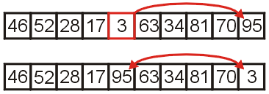
Example Heap Sort
8.4.4
We compare 3 with its child and swap them

Slide 32
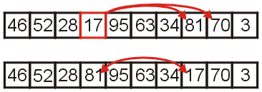
Example Heap Sort
8.4.4
We compare 17 with its two children and swap it with the maximum child (70)

Slide 33
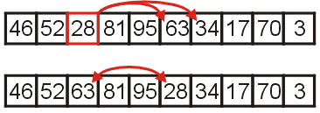
Example Heap Sort
8.4.4
We compare 28 with its two children, 63 and 34, and swap it with the largest child

Slide 34
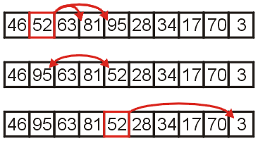
Example Heap Sort
8.4.4
We compare 52 with its children, swap it with the largest
Recursing, no further swaps are needed

Slide 35
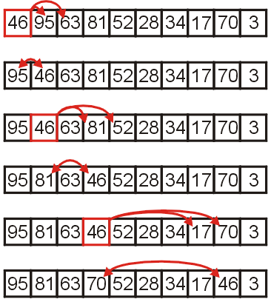
Example Heap Sort
8.4.4
Finally, we swap the root with its largest child, and recurse, swapping 46 again with 81, and then again with 70

Slide 36
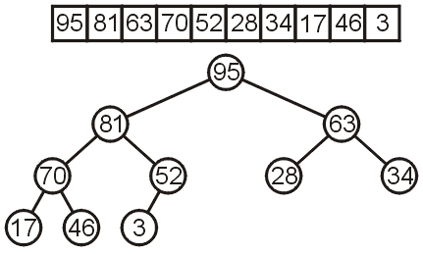
Heap Sort Example
8.4.4
We have now converted the unsorted array
into a max-heap:

Slide 37
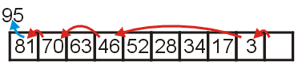
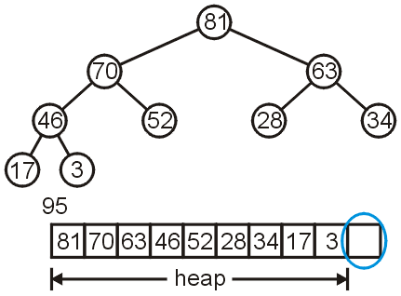
Heap Sort Example
8.4.4
Suppose we pop the maximum element of this heap
This leaves a gap at the back of the array:

Slide 38
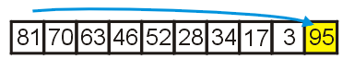
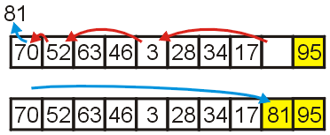
Heap Sort Example
8.4.4
This is the last entry in the array, so why not fill it with the largest element?
Repeat this process: pop the maximum element, and then insert it at the end of the array:

Slide 39
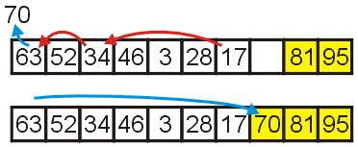
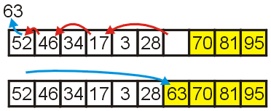
Heap Sort Example
8.4.4
Repeat this process
Pop and append 70
Pop and append 63

Slide 40
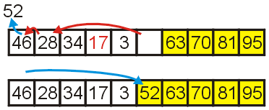
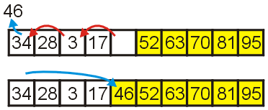
Heap Sort Example
8.4.4
We have the 4 largest elements in order
Pop and append 52
Pop and append 46

Slide 41
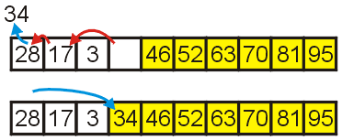
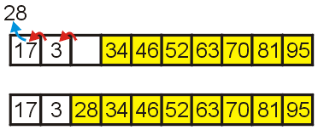
Heap Sort Example
8.4.4
Continuing...
Pop and append 34
Pop and append 28

Slide 42
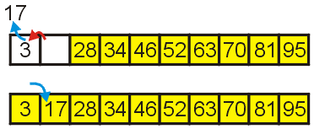
Heap Sort Example
8.4.4
Finally, we can pop 17, insert it into the 2nd location, and the resulting array is sorted

Slide 43
Black Board Example
8.4.5
Sort the following 12 entries using heap sort
34, 15, 65, 59, 79, 42, 40, 80, 50, 61, 23, 46

Slide 44
Heap Sort
8.4.6
Heapification runs in Θ(n)
Popping n items from a heap of size n, as we saw, runs in Θ(n ln(n)) time
We are only making one additional copy into the blank left at the end of the array
Therefore, the total algorithm will run in Θ(n ln(n)) time

Slide 45
Heap Sort
8.4.6
There are no worst-case scenarios for heap sort
Dequeuing from the heap will always require the same number of operations regardless of the distribution of values in the heap
There is one best case: if all the entries are identical, then the run time is Θ(n)
The original order may speed up the heapification, however, this would only speed up an Θ(n) portion of the algorithm

Slide 46
Run-time Summary
8.4.6
The following table summarizes the run-times of heap sort
Case | Run Time | Comments
Worst | Θ(n ln(n)) | No worst case
Average | Θ(n ln(n))
Best | Θ(n) | All or most entries are the same

Slide 47
Summary
8.4.6
We have seen our first in-place Θ(n ln(n)) sorting algorithm:
Convert the unsorted list into a max-heap as complete array
Pop the top n times and place that object into the vacancy at the end
It requires Θ(1) additional memory—it is truly in-place
It is a nice algorithm; however, we will see two other faster n ln(n) algorithms; however:
Merge sort requires Θ(n) additional memory
Quick sort requires Θ(ln(n)) additional memory

Slide 48
References
Wikipedia, http://en.wikipedia.org/wiki/Heapsort
[1] Donald E. Knuth, The Art of Computer Programming, Volume 3: Sorting and Searching, 2nd Ed., Addison Wesley, 1998, §5.2.3, p.144-8.
[2] Cormen, Leiserson, and Rivest, Introduction to Algorithms, McGraw Hill, 1990, Ch. 7, p.140-9.
[3] Weiss, Data Structures and Algorithm Analysis in C++, 3rd Ed., Addison Wesley, §7.5, p.270-4.
These slides are provided for the ECE 250 Algorithms and Data Structures course. The material in it reflects Douglas W. Harder’s best judgment in light of the information available to him at the time of preparation. Any reliance on these course slides by any party for any other purpose are the responsibility of such parties. Douglas W. Harder accepts no responsibility for damages, if any, suffered by any party as a result of decisions made or actions based on these course slides for any other purpose than that for which it was intended.

